Slide 1
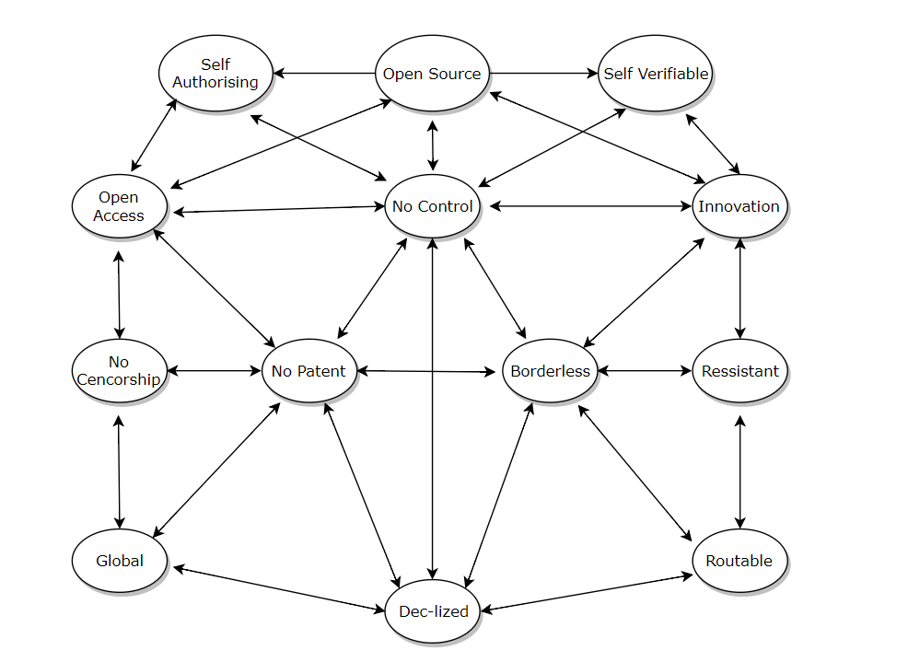

Slide 3
YOU DO NOT NEED A BLOCKCHAIN!
Thank you. Questions?
Simanovsky Sergey:
@serejandmyself1 +79056225910

